Slide 1
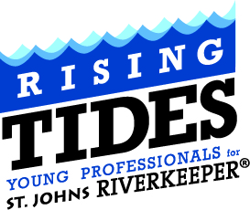
Our Vision: to inspire young professionals to actively participate in the advocacy of St. Johns RIVERKEEPER.
Our Mission: to provide members with fun, rewarding social events on and along the St. Johns River.

Slide 2
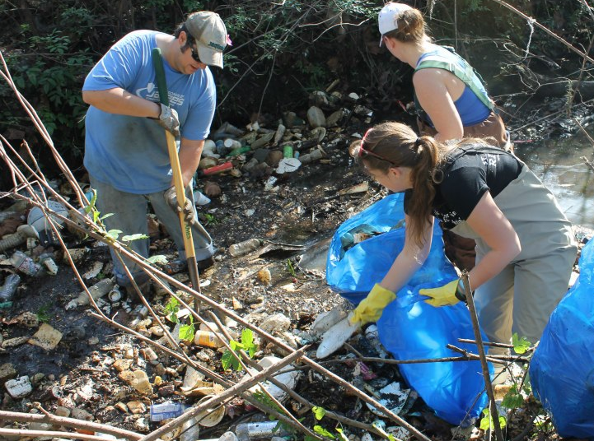
Downtown Kayaking
McCoys Creek, 2012

Slide 3
December 2012
McCoys Creek Cleanup
7 people
Over 20 bags of trash and additional debris
We decided to come back in 2013

Slide 4
McCoys Creek
2.5 miles in main stem
Watershed extends from Murray Hill - West
Flows under McDuff Ave. and Hwy-17
Crosses Beaver Street – North
Flows through North Riverside, under King Street and Stockton Street
Flows under I-10 interchange
Enters Brooklyn Neighborhood at Brooklyn Park
Passes new Brooklyn Apts - East
Enters St. Johns River under the Times Union Building - End

Slide 5
Powers Park
Just outside of the Murray Hill neighborhood

Slide 6
Hollybrook Park
North Riverside
Between Bold City Brewery and Eco Relics

Slide 7
Hollybrook Park
At Stockton Street

Slide 8
McCoys Creek Blvd.
Long greenway, near CASH building

Slide 9
McCoys Creek
Enters under the Times Union Building

Slide 10
St. Johns River
Northbank Riverwalk at Haskell

Slide 11
2013
Goal: Break apart trash and debris dams
Goal: Restore flow to the creek
Goal: 12 cleanups in 1 year

Slide 12
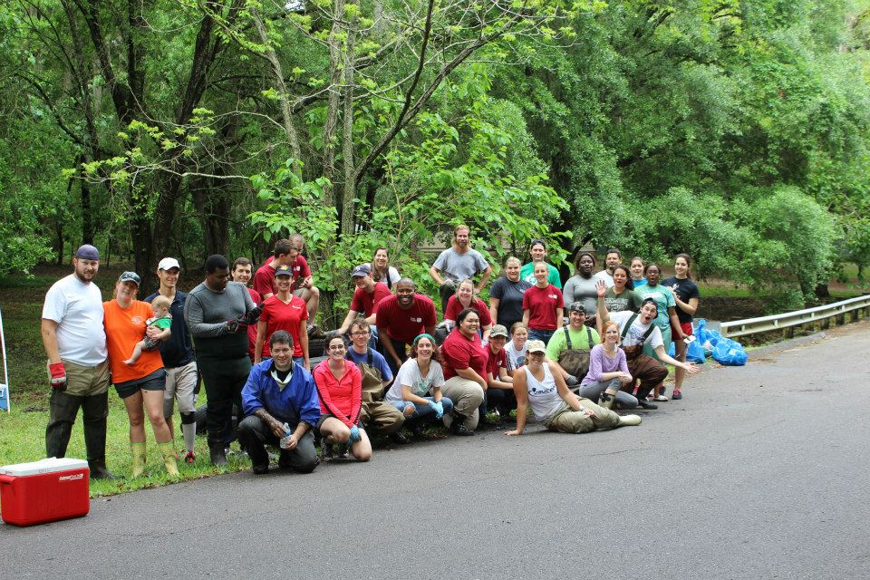
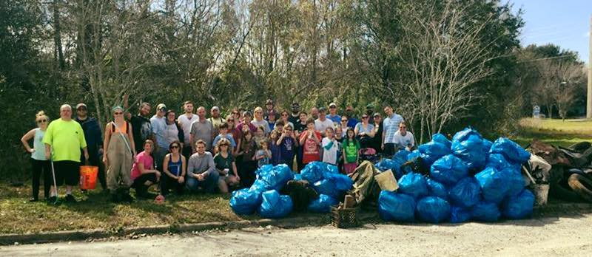
2014
Goal: Bring more people to the water
Goal: Get more locals, neighbors to the cleanups
Goal: Make it fun!
2014 STATS
510 Volunteers
30 Hours of Cleanups
636 Bags of Trach
121 Tires

Slide 13
2015
Goal: If we are going to be here a while; lets make it fun
Goal: Use partnerships to leverage educational expertise and knowledge, events
UNF Environmental Center – Invasive Species Removal Classes
Dr. Radha Pyati – Health of McCoys Creek talk at Southern Roots
Cleanup Prizes and Contests from Bold City Brewery and Intuition Ale Works
Beer brewed to benefit the Emerald Necklace from Engine 15 Brewing Co.
North Florida Land Trust and Greenscape of Jacksonville using corporate grants to plant trees

Slide 14
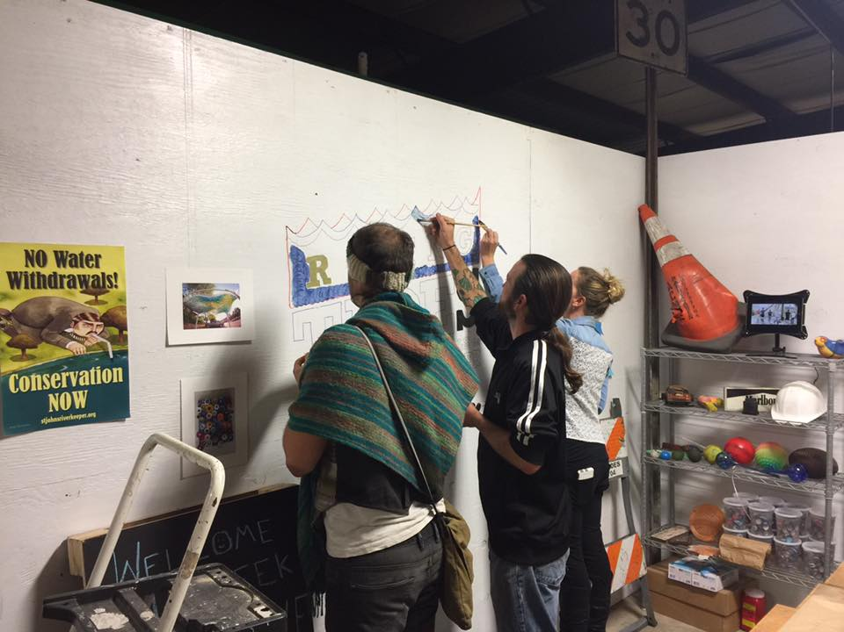
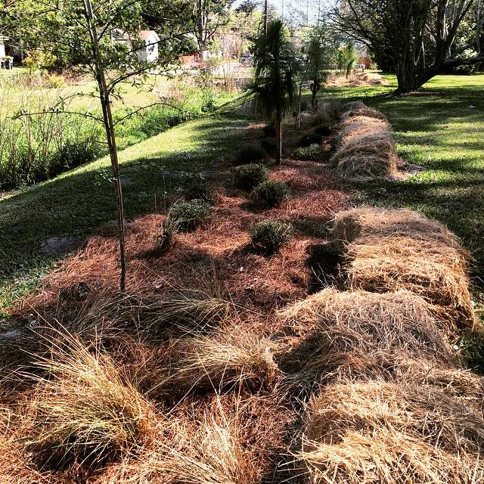
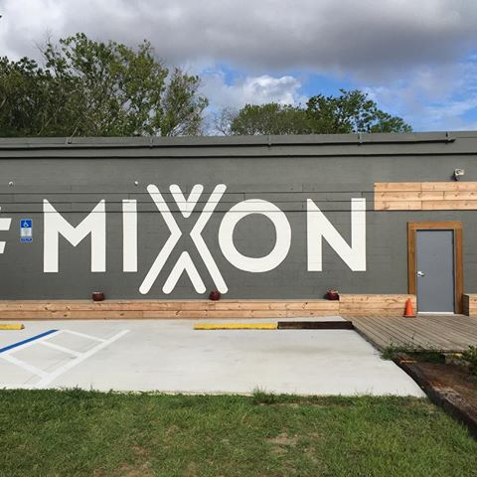
2016
Goal: Invest in long-term solutions
Goal: Engage the art community
Goal: Think Solutions
We planted trees and grasses along a headwaters section of the creek to prevent debris from entering
We partnered with Mixon Studios to clean and keep found items from the creek in order for artists to repurpose into sculpture

Slide 15
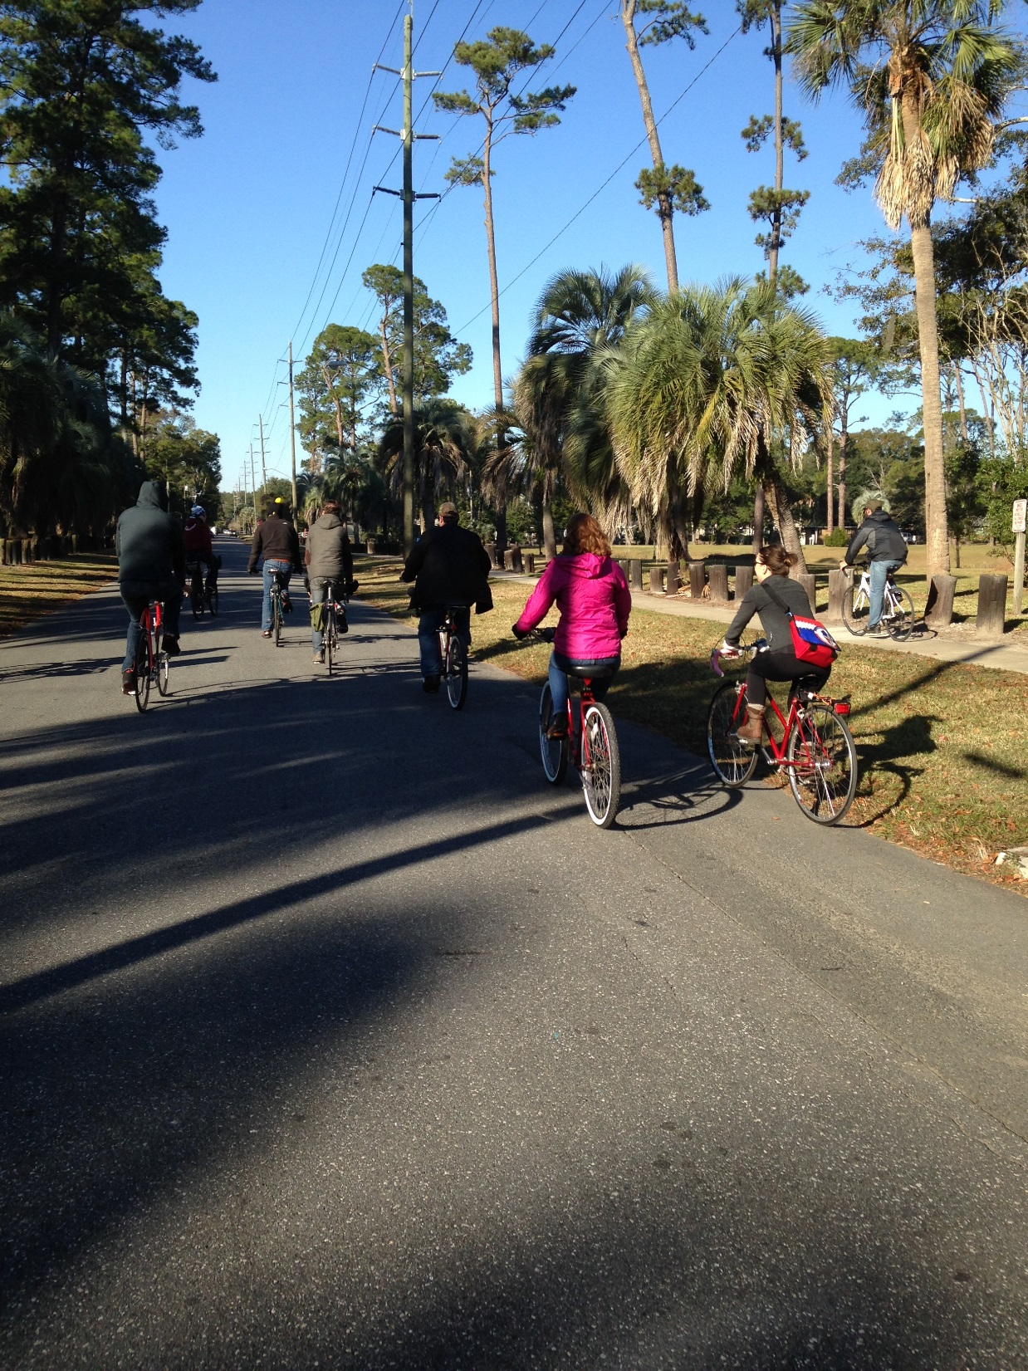

Slide 16
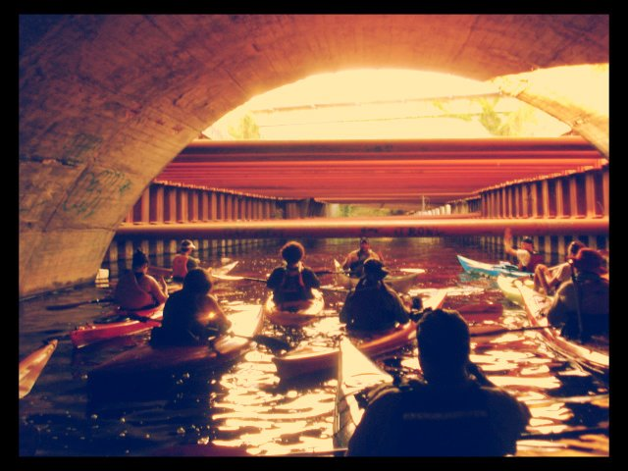

Slide 17
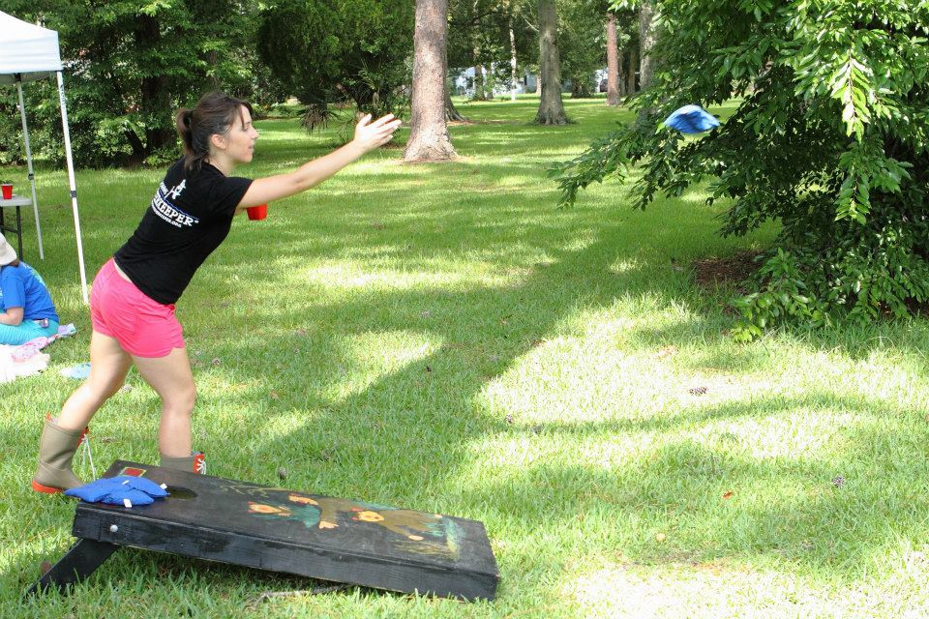

Slide 18
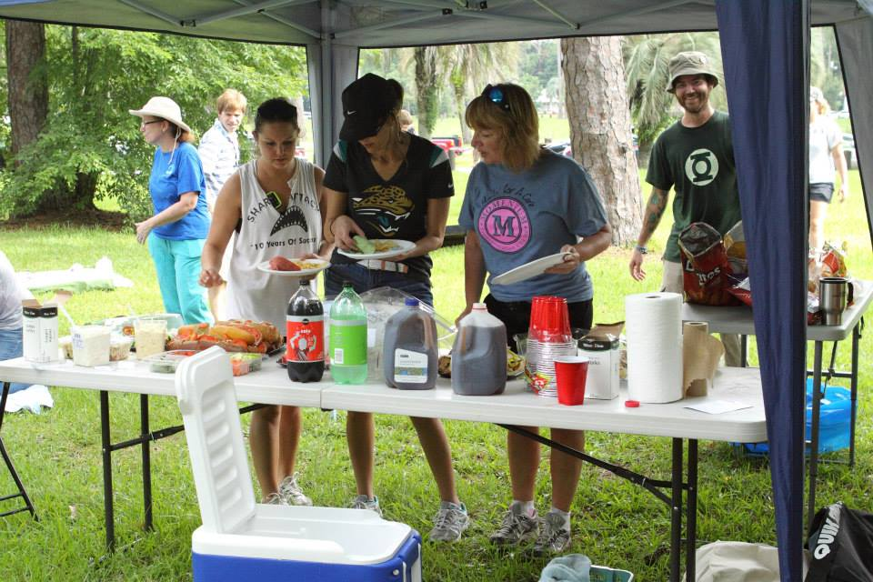

Slide 19
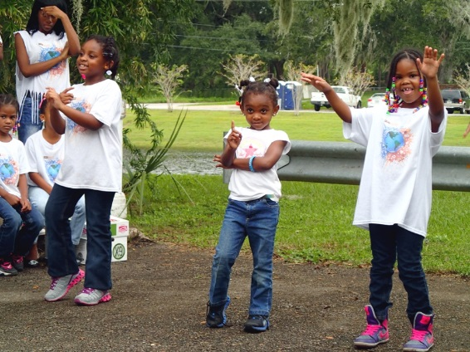

Slide 20
Typical pull of litter from McCoys Creek
Tires
Debris
Yard waste like trash cans, kids toys, balls and landscaping material, fencing
Litter like cigarette butts, plastic bottles, beer cans
Paraphernalia like needles and drug bags
Items from daily life, garbage cans
Illegal dumping

Slide 21
Stormdrain Outfall
Sediment buildup
Litter
Standing water, algae
Corner of Cherokee St. and Edison Ave.

Slide 22
Infrastructure
Allows for direct access to our creek from stormwater
Old bridges need to be enlarged, repaired, repainted
Stormdrains need to be redirected to greenway, not creek
Floodplains need to be restored
Mowing to the edge of the creek must stop

Slide 23
Emerald Necklace
Large greenways on McCoys Creek
Lack of connection to the Northbank Riverwalk
Large greenways on Hogans Creek
Lack of connection to McCoys Creek
Emerald Necklace, part of the downtown Jacksonville master plan
Should incorporate restoration of McCoys Creek at the mouth allowing for recreation to the St. Johns from our historic neighborhoods

Slide 24
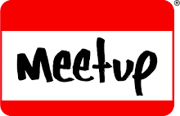
NEXT CLEANUP
March 25, 9:00 a.m. – Noon
Hollybrook Park
#mccoyscreek #mccoyscreekcleanup
FIND US
The Rising Tides
@therisingtides
Rising Tides
www.stjohnsriverkeeper.org/events

